Slide 1
Project-1
Deploying Three-Tier Architecture In AWS Using Terraform
Y Deepthi

Slide 2
AGENDA
Primary Goals
Pre-Requisites
Project Pipeline

Slide 3
TERRAFORM
Terraform is a tool for building ,changing and versioning infrastructure safely and efficiently.
Terraform can manage existing and popular service providers as well as custom in-house solutions.

Slide 4
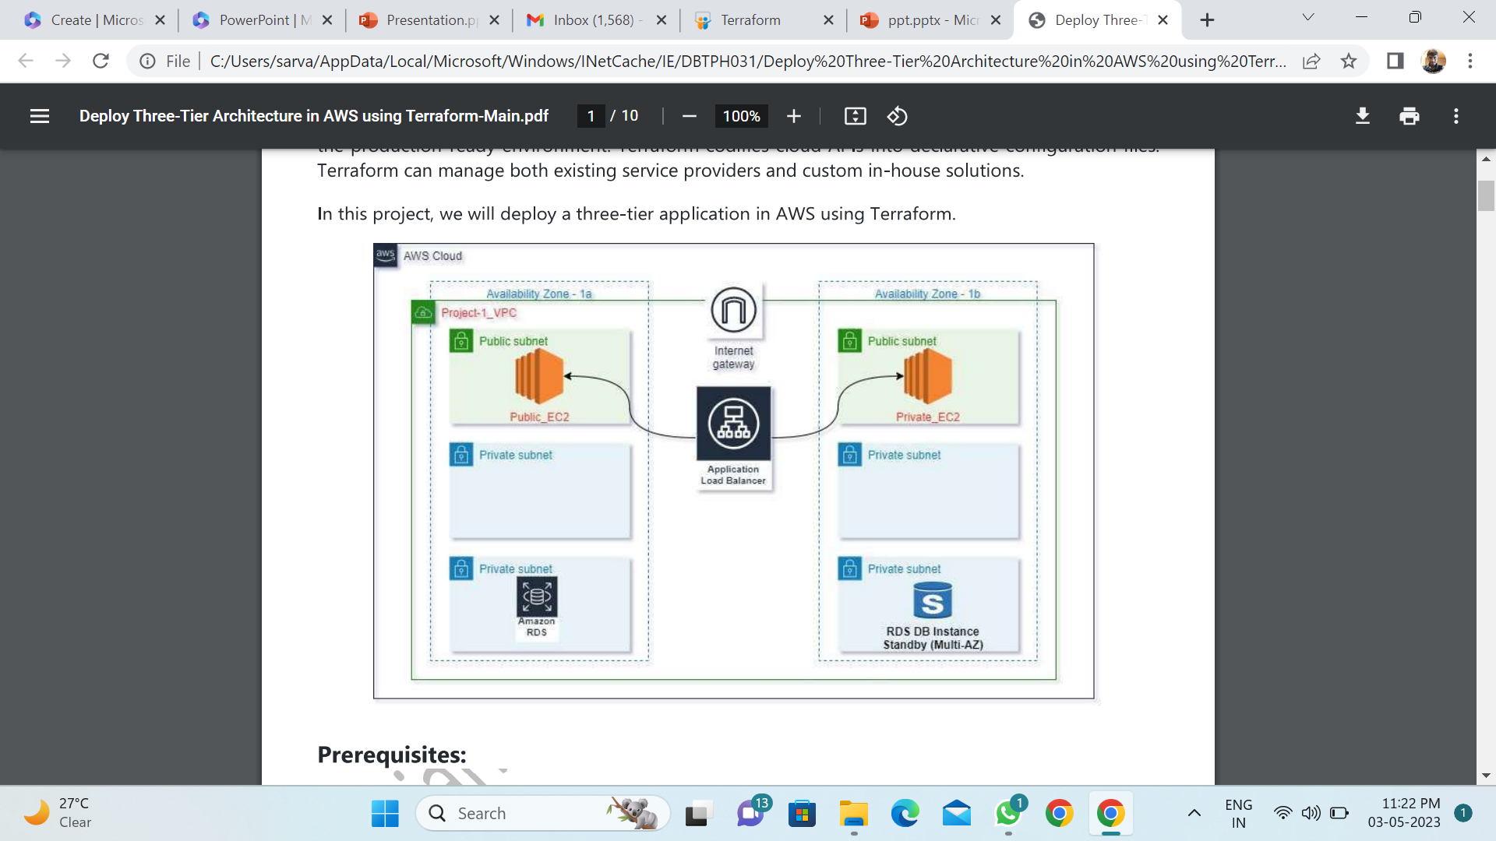
Primary Goals
Deploying all the
Resources required
For three-tier
Architecture in aws

Slide 5
Pre-Requisites
AWS account
IAM user
AWS access key & secret key
Github

Slide 6
Create file for vpc
Create file for subnets
Create file for igw
Create file for routetable
Create file sg for frontend-tier
Create file sg for database-tier
Create file for user data
Create file for ec2 instances
Create file for alb
Create file for rds
Create file for variables
Create file for output
Project Pipeline

Slide 7
Future Scope
We can use auto scaling , for high availability ,no down-time, self-healing .by means auto scaling which creates automatically servers if there is heavy traffic on a server

Slide 8
THANK YOU

